Slide 1
Welcome to
TATA Consultancy Services
Canada

Slide 2
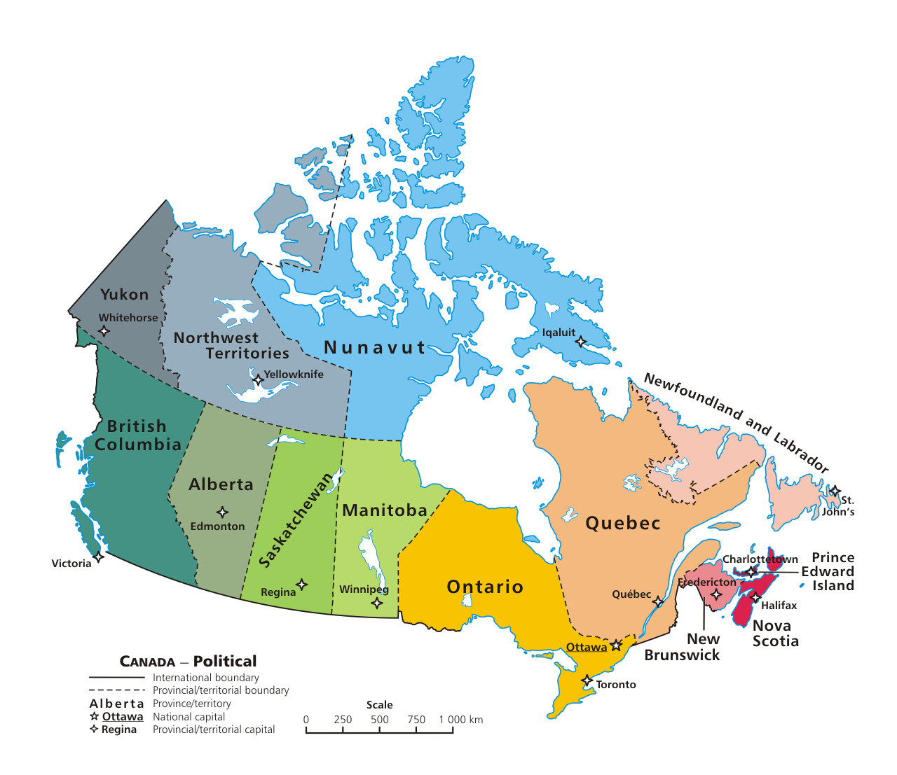

TCS Canada Orientation Presentation for Expatriate Associates – Must Know
August 11, 2022

Slide 3

Things to do before you Fly
VISA FOR DEPENDENTS (Connect with your Base Branch GMFU)
Apply Visitor Visa for Spouse
If your child’s age is 4 or above, you will need to apply for Study work permit. (If age is below 4, please apply for visitor record). You can get guidance from globalmobility.canadavisa@tcs.com.
Bring your Child/Children Grade completion or Transfer Certificate from India School (Home Country School)
Bring Child/Children vaccination record and Birth Certificate from India (Home Country). It is mandatory for school admission.
To obtain a Canadian driving license please check with the local (Province of travel) Ministry of transportation website for more information. (www.drivetest.ca). Please carry your Indian driving license and an extract of driving license (which could be obtained from your RTO in India/Home Country), this may help in faster processing to obtain Canadian driving license.
Please Complete the Mandatory trainings given in Slides 5 & 6.
Apply For Certificate Of Coverage (COC). Details are provided in slide 4
Kindly ensure that the spouse and child travel only through GESS travel request. No reimbursement shall be made if the GESS Travel flow is not followed and will not be enrolled for benefits in Canada.

Slide 4
How to access application form for CoC
Things to do before you Fly
What is Certificate of Coverage (COC)?
India Employee’s Provident Fund Organization (EPFO) has made it mandatory for applicants travelling to Social Security Agreement (SSA) countries (Canada being one of them) to fill the Online CoC form as per the SSA agreements. SSA aims at eliminating dual social security contribution in two countries for the same period. As such the employees travelling to these countries from India will contribute to Indian social security scheme (i.e. PF) and can be excluded from social security contributions in the country of deputation based on the Certificate of Coverage (CoC), which is granted based on certain eligibility criteria being met.
Step 1 : Go to www.epfindia.com
Step 2 : Click on International Workers Portal for CoC
Step 3 : Click on Application for CoC
Step 4 : Enter UAN number
Step 5 : Please fill all the details
Step 6 : Once all the details are filled, kindly verify the details and submit the CoC request
Step 7 : Download the duly filled CoC application and sign across at the place of employee.
Step 8 : It is compulsory to get your CoC application verified from location Globalmobility relocationcompliance team.
Step 9 : Post verification and approval from Globalmobility relocationcompliance team, upload the application on EPFO portal
Step 10 : You can track the status of your online CoC request on https://iwu.epfindia.gov.in/iwu/trackAppStatus by entering the reference no. of CoC & DOB
Note: Document to guide you fill COC form is attached for reference. Alternatively, please follow the link below:
Ultimatix - > Applications -> Learning & collaboration -> KNOWMAX-> My HR -> India -> Mobility -> International Travel ->TCS India User Manual – Certificate of Coverage Application Form
Notes:
Global Speed is our Performance Review system. During your first year at TCS, you will not have use for this system, UNLESS you are a people-manager. If you manage people, this will be the system where you go to complete the half-yearly reviews and set the half-yearly goals for your direct reports.
If you are not a people-manager, you will not access this system until you complete your first year. Your first review is an annual one, and will be done manually. Your HR person will tell you more about this process in the next few weeks and months, as you get settled in. You will work with your manager to set goals for yourself after you have been here for 2-3 months.

Slide 5
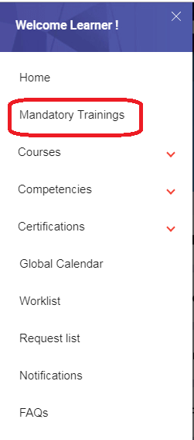
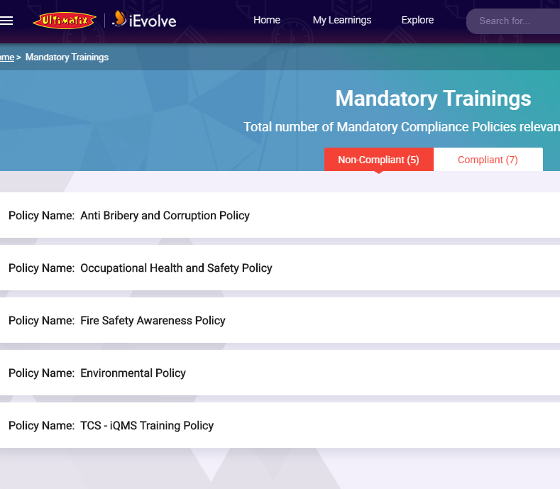
Mandatory Trainings (iEvolve) to do before you fly
You need to complete mandatory trainings on iEvolve (ultimatix) and HR downloads (External training Module)
List of Mandatory Trainings:
iEvolve
1. iEvolve Compliance Trainings
Path: Ultimatix -> Learning & Collaboration -> Learning -> iEvolve -> Learner Portal-> Launch -> Courses -> Mandatory Trainings(shown in fig 1)(Please complete all these trainings, non compliance will impact your access to TCS systems)
fig 1

Slide 6
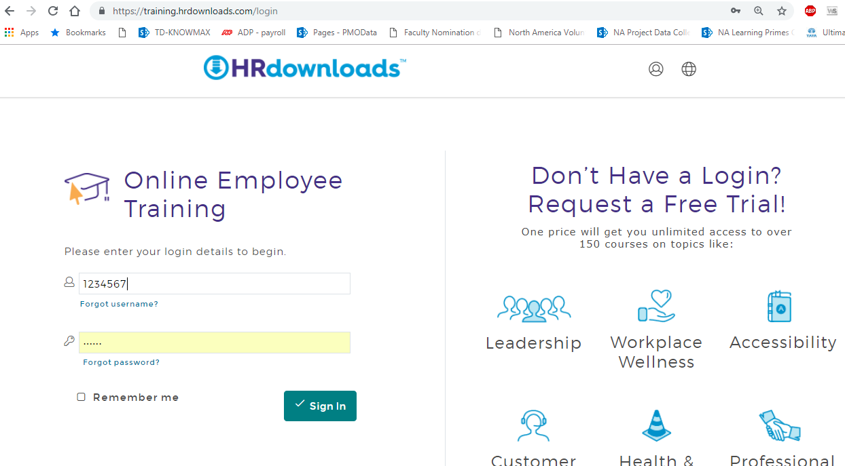
Mandatory Trainings to do before you fly – (HR Downloads)
You will be sent an email from HR Downloads to complete training modules #1-19 as per your work location
HR Downloads – Ontario Province
1. Accessibility for Ontarians with Disabilities Act (AODA) – Applicable only if your work location is Ontario
2. Workplace Violence and Workplace Harassment
3. Occupational Health and Safety Awareness
4. Understanding Human Rights Training.
HR Downloads – British Columbia Province
5. Fire Safety Training
6. Preventing Workplace Bullying, Harassment and Violence Training.
7. Occupational Health and Safety Awareness training for Workers
8. Improving Workplace Accessibility General Training for leaders in all Jurisdictions
HR Downloads – Saskatchewan Province
9. AODA Customer Service Training
10. Occupational Health and Safety Awareness Training for Workers
11. Respect in the Workplace Training
Default Login Credentials
url: https://training.hrdownloads.com
Username: <your empid>
Password: tcs12345

Slide 7
Mandatory Trainings to do before you fly – (HR Downloads)
HR Downloads – Manitoba Province
12. Manitoba’s Accessibility Standards for Customer Service
13. Occupational Health and Safety Awareness training for Workers
14. Respect in the workplace training
HR Downloads – Quebec Province
15. Occupational Health and Safety Awareness training for Workers
16. Respect in the workplace training
HR Downloads – Alberta Province
17. Evacuation Plans & Procedures Training
18. Occupational Health and Safety Awareness Training for Employees
19. Workplace Violence and Harassment Training (Alberta)

Slide 8
While Travelling
AT PORT OF ENTRY (Travelling along with Dependents or Dependents Travelling Alone)
You may not get the Visitor Record at Port of Entry for your Spouse or Children who are less than 4 Years Old. In such scenario, please do not insist or engage in discussion with the officer to issue the visitor record. We have a process to apply visitor record online. Please notify TCS Canada Visa team if visitor record is not issued at the port of entry.
If your dependents are not issued Visitor records at the port of entry, Immigration officer will stamp your Spouse/child passport only for 6 Months Validity (Stamp or Handwritten date). Once you report to work please approach globalmobility.canadavisa@tcs.com. Team will facilitate the extension process and you can get the Visitor records for your spouse/child which will be valid until your WP expiry.
Make sure to carry contact numbers of your Onsite Managers, TCS Canada Immigration Manager and Attorneys who processed your work permit application package if something goes wrong.
Please ensure that you read the TCS Canada letter before travelling, to ensure that you are familiar with the contents of same in case an immigration officer ask questions of your role in Canada.
Please ensure that you inspect the contents of your Work Permit when it is issued, to make sure that the location, occupation, employer and validity are correct.
Please be courteous to officials at the port of entry.
If dependents are travelling alone(when employee is already in Canada), please ensure they bring recent payslips, copy of your Work Permit, their passports with valid visas, and Port of entry approval letters. Your spouse should also bring your marriage certificate and birth certificates for children in original.
You can request the Immigration officer at Port of entry counter to issue Study Permit for your Children who are 4 or above. You should carry the study permit approval which was issued by CHC.
If travelling with family, please ensure that you bring your signed TCS Letter of Support (on TCS letterhead and signed by a TCS manager), passport with valid W-1 visa, and Port of entry approval letter. It is advised to bring your marriage certificate and birth certificates of children in original.

Slide 9


Port of entry - Briefing
Hey Immi ! How are you? I am all set to fly to Canada
Congratulations John ! But hey, wait, are you all set for the port of entry formalities?
Umm…not sure. Tell me about it.
Do carry all the documents that you had submitted in support of your visa/work permit application and show only those documents to the officer for review at port of entry as requested. Please carry your passport, complete WP approval package submitted with CHC/IRCC, all certificates submitted for visa stamping, secondment letter and deputation agreement.
Great that you told me that. So after that I am all set to start working. Right ?
You must show the Port of entry approval letter to the first CBSA officer you meet after landing or at a land border. You must insist to obtain the work permit even if the officer wants to wave you through. Ask for direction to CIC officer to obtain printed work permit in the adjacent Immigration office.
Oh Immi ! You are a savior. Any formalities for my family too?
Yes John ! Whether they are travelling with you or alone, they must obtain the Visitor Record at the adjacent Immigration Office. If they are travelling alone they should carry copy of your passport, visa and WP pages, original marriage & birth certificates of child / children and degree certificate of the spouse.
Would you like to give any quick tips on the questions by officer?
Answer all questions by the CBSA officer truthfully. Any misrepresentation can result in enforcement action against you. And do not volunteer irrelevant information that is not asked of you.
I am glad that I dropped by. Got so much to learn !
And last but not the least, it is imperative that you review your WP carefully when issued. Don’t forget to verify your name, DOB, occupation, location and employer (TCS Canada Inc.) is listed correctly. It’s quicker and cheaper to get it corrected at the immigration office than later where amendment may take upto 4 months. All the best ! I am sure the process will be very smooth. Happy Journey John !
Thanks for your help Immi !!

Slide 10
Prepare Yourself
Carry all immigration documentation issued, including port of entry approval letter (Issued by IRCC / CHC Delhi).
Carry copy of entire presentation made to visa office to be included in candidate's briefcase.
Be familiar with TCS’ operations in Canada, including the correct company name (Tata Consultancy Services Canada Inc.), the location of the head office, the city and province where you will be working, the name of your TCS manager in Canada and the approximate size and structure of the TCS team on your project.
Check with Base branch GMFU / TCS Canada Visa Team or Onsite Immigration team to make sure that all documentation are correct.
Read over all points made, to avoid inconsistencies.
Candidate must point out any inaccuracies in understanding of job, or past, or experience, to Visa team.
Ensure passport is valid for at-least 1 year.
Have clear copies of supporting documentation (e.g. educational certificates, Marriage Certificates, Birth Certificates. Etc.).
Ensure that any documentation not in English or French is accompanied by an official translation.
Make sure that there are contact numbers available if something goes wrong (Your Onsite Manager, TCS Onsite Immigration Manager, Lawyers who processed your work permit and TCS HR in Toronto, etc).
Before leaving immigration ensure that name, date of birth, citizenship is all correct on the document once issued.

Slide 11
What to expect
Wait in the line quietly and patiently for your turn. There may be a long line-up.
Do not use cell phone while you are in the Canada immigration area without permission.
Handover only the passport and Port of entry approved Letter to the officer. Be ready with other documents and produce other documents if asked.
Answer the questions clearly and confidently.
Be forthright and do not suppress any information, but limit your answers to the questions asked of you.
All applicants for work permits must report for secondary inspection. Business visitors may also be selected for secondary inspection, either randomly or if the primary officer has any doubts that cannot be resolved at the counter.
Applicants are interviewed and documents are verified by the secondary officer. In such cases, it is possible they may call your supervisor & client for further verification.
Expected Questions
What is your purpose of Travel?
How long you are planning to stay in Canada?
Who is your employer?
Tata Consultancy Services Limited. Please don’t mention your client name as employer
Who is your employer’s Canadian customer?
Mention your Client Name
What type of business meeting are you attending during your stay in Canada?
What exactly you will be doing in Canada?
Your Job duties

Slide 12
Important tasks upon your landing in Canada
Update your Work Permit details in Ultimatix > GESS > Travel > My travel essentials > WP/RP Details. (System will allow you to complete your Onsite reporting form only after updating and approval of your WP details in WP/RP link. Instructions given in Slide 18).
Complete your Onsite Reporting Form, Ultimatix > GESS > FYA Worklist. Ensure that your Onsite Reporting form is approved by all stake holders. (If you have any issues in submitting Onsite Reporting Form, please try different browsers (IE, Mozilla, Chrome)
Update your overseas residence address in Ultimatix > GESS > My Profile > About > Address Details > Create Overseas.
(You can update the address where you are temporarily staying immediately after arrival or update TCS office address or update your short term accommodation on landing. But make sure to edit the address in the above path immediately after you move into your long term accommodation. Correct address is required for various purposes (Banking, Insurance, TCS HR to contact etc..)
Check the completion of your Overseas Deputation process (Ultimatix > GESS >Track My Workflows ). If there are pending notifications, contact the concerned departments to clear the notifications.
Open a Bank Account. The salary (Indian and Canada), and claims will be remitted to this account. Please update the bank account details in Ultimatix > GESS > My Profile > Bank Details > Create Overseas.
Apply for your Social Insurance Number (SIN #) (Please check the internet for the nearest Service Canada office location . Web site - http://www.servicecanada.gc.ca). Please update your SIN Details in Ultimatix > GESS > My Profile > National Identifier > Canada (Should choose the country from the drop down & format should be xxx-xx-xxxx). This is mandatory for payroll processing. (Please carry your Original work permit issued at the port of entry and original passport while applying for SIN. SIN will be provided immediately at the counter. SIN is not required for dependents who are in Visitor Record or Study Permit).

Slide 13
Important tasks upon your landing in Canada
Please fill out the required Tax Forms . Please complete your TD1 under below link. (Ultimatix  Global ESS  Benefits and Taxes  Tax Manager). Please find the detailed Tax information on Knowmax.
You may also refer to these government websites
http://www.cra-arc.gc.ca/formspubs/frms/td1-eng.html. (Federal)
http://www.cra-arc.gc.ca/formspubs/frms/td1-eng.html(Provinical)
http://www.revenuquebec.ca/en/sepf/formulaires/tp/tp-1015_g/default.aspx(Quebec)
Visitor Records for Dependents –
If your dependents are not issued Visitor records at the port of entry, Immigration officer will stamp your Spouse/child passport only for 6 Months Validity (Stamp or Handwritten date). Please approach globalmobilitycanadavisa@tcs.com after you report to work. Team will facilitate the extension process and you can get the Visitor records for your spouse/child which will be valid until your WP expiry. It’s a mandatory document for applying PHIP (Government Insurance Coverage). Please review TIPs before and After Travel documents in Knowmax for more details. Ultimatix - Learning & Collaboration - Knowmax - My HR - North Americas - Canada - Mobility – Orientation
To obtain an employment verification letter, please raise a request. Ultimatix>Employee Services>Global ESS>Employee Perks >Bonafide Letter
They will provide you with a soft copy of the Reference letter. Important- For Provincial Health Card, you need to submit the proof of your residence address in Canada. Please submit a copy of your rental agreement.
(You will require an employment verification letter for Banking Purpose, obtain Provincial Health Insurance Coverage, Rental accommodation & visa extension etc..)

Slide 14
Important tasks for Insurance upon your landing in Canada
Immediately upon arrival, you will have to raise GHD ticket under below path to activate your Medical Insurance coverage –
Menu > Applications > Employee Services > Help & Support > TCS Global Helpdesk > Ultimatix Services / CR Tool > Launch > Raise New Ultimatix Ticket > Select Category: Ultimatix Services > Type Issue Description > Select Type: Canada Payroll > Select Item: Canada – Insurance. .
Please include all dependents in the form for whom a GESS travel request has been raised as this is a pre-requisite for enrollment. If your dependents arrive in Canada at a later date, please raise GHD ticket under below path.
Menu > Applications > Employee Services > Help & Support > TCS Global Helpdesk > Ultimatix Services / CR Tool > Launch > Raise New Ultimatix Ticket > Select Category: Ultimatix Services > Type Issue Description > Select Type: Canada Payroll > Select Item: Canada – Insurance. .
Apply for the MANDATORY Provincial Health Insurance Plan (PHIP) upon arrival to Canada. This is administrated and delivered by each province or territory to ensure all Canadian residents have reasonable access to medically necessary hospital and physician services without direct charges. Please check Slide 35 & 36 for eligibility guidelines applicable in your province.
It is strongly recommended you evaluate the option to enroll in the optional term life(life insurance), AD&D and critical illness coverage available to you in Canada through our insurance provider. While in Canada TCS Benefit plan does not include Life Insurance. Only Life Insurance coverage (for self) given in India will continue and cover you while in Canada . If you wish you can enroll for these additional plans, available to you as a separate, portable, individual billing option to enhance your insurance coverage. For premium rates and details on how to enroll, please refer to slide 34.
Please note that Coverage automatically expires at 21 years for dependent children.

Slide 15
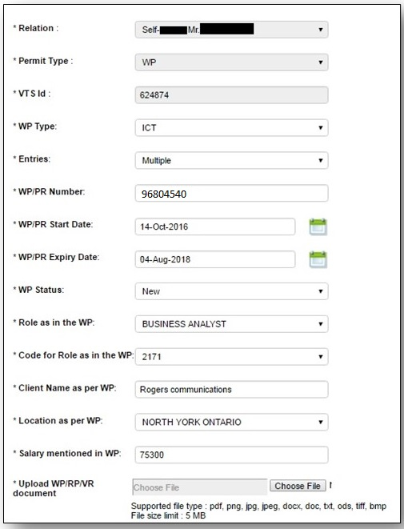
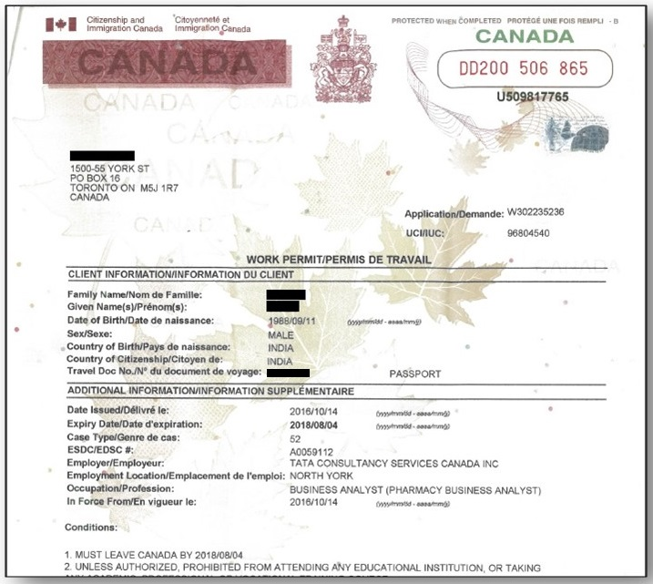
Instruction to update Work permit details in WP/RP link
The client for which you have travelled to Canada
Refer NOC code in TCS Canada letter in approval package released by Canada Visa Team
Refer TCS Canada letter in approval package released by Canada Visa Team

Slide 16
HR Contact Details
HR Point of Contact | Area of Responsibility | Phone Number | Email
Rohit Tiruvalluru | BFSI TE Lead | 647-790-7418 | rohit.t@tcs.com
Vishwas Sharma | Non BFSI TE Partner | 416-999-7585 | vishwas.s@tcs.com
Madhura Khadye | BFSI TE Partner | 647-790-7405 | madhura.khadye@tcs.com
Treesa Thomas | BFSI TE Partner |  | treesa.thomas@tcs.com
Debra Winchester | Lead – Talent Acquisition | 647-790-7409 | debra.winchester@tcs.com
Pragya Gupta | Campus Recruitment Lead |  | pragya1.g@tcs.com
Ramkumar D | Campus Recruitment Lead |  | d.ramkumar4@tcs.com
Arun G K | RMG Lead |  | arun.gk@tcs.com
Suresh Mohanraj | Immigration Lead | 647-790-7420 | suresh.mohanraj@tcs.com
Balakrishnan R | Immigration Specialist |  | balakrishnan.r5@tcs.com
Angely Vatcher | Lead - Diversity and Inclusion |  | angely.Vatcher@tcs.com
Vidhi Sharma | Talent Development | 778-723-1414 | vidhi1.s@tcs.com
Sampatti Wagh | Total Rewards, Policy and HR Analytics |  | Sampatti.wagh@tcs.com
Anand Selvaraj | Audits and Compliance Lead |  | Selvaraj.anand@tcs.com
Susie Luu | Benefits Specialist | 647-790-7413 | p.luu@tcs.com

Slide 17
HR Contact List
Point of Contact | Area of Responsibility | Phone Number | Email | Point of Escalation
Canada Insurance | Activation of enrollment, changes in coverage (addition/termination of coverage, changes in address, name, etc.) | Ultimatix > Applications > Employee Services > Help & Support > TCS Global Helpdesk > Ultimatix Services / CR Tool > Launch > Raise New Ultimatix Ticket > Select Category: Ultimatix Services > Type Issue Description > Select Type: Canada Payroll > Select Item: Canada – Insurance. |  | p.luu@tcs.com
 | Inquiries related to British Columbia Enrollments
Susie Luu | Employee and Family Assistance Program | 647-790-7413 | p.luu@tcs.com | Sindhu.john@tcs.com
 | Medical claim-related questions, detailed benefits, coverage-related details, etc.
 | Short/long term disability application
Benefits Team | Queries related to TCS Gems | - | tcs.gems@tcs.com | -
 | Employee referral/Bring Your Buddy technical issues | - | tcs.budzee@tcs.com | -
 | Employee referral/Bring Your Buddy inquiries related to claims and processes |  | debra.winchester@tcs.com | -
Admin | Business cards, car, mobile phone, and laptop requests | - | Ben.m@tcs.com
NAHR Backoffice | If you need an employment verification letter | - | nahr.backoffice@tcs.com | r.nithya@tcs.com
COC | Helpdesk ticket for COC related queries | Ultimatix->Employee Services->TCS Global Helpdesk->IT Services & Others->Raise New Ticket->HR Services. |  | s.nair11@tcs.com
Finance/Payroll Team | Any payroll related inquiries | Log ticket in Employee Services -> TCS Global Helpdesk -> Ultimatix Services -> Launch -> Raise New Ultimatix Ticket -> Canada Payroll |  | m.chelvaratnam@tcs.com
 | Salary slip Download | Ultimatix – Employee Services – My Documents

Slide 18
Canada Compensation Structure

Slide 19
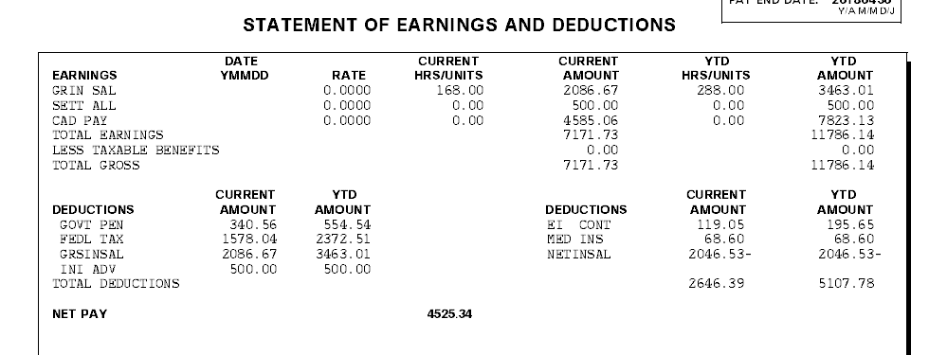
Compensation in Canada for Expatriates from India
While on Long Term Deputation to Canada :
Associates are eligible for a Gross Consolidated Salary (CS).
Consolidated Salary is based on Grade, Role and Location and defined based on the prevailing wages applicable in the location.
Consolidated Salary (CS)= India Salary (IS) + Living/Other Allowance(Canada Pay).
Any changes to the Consolidated Salary of the associate due to changes in the India Salary (increments, promotions, etc.) is informed through a Canada Salary Change letter available in Ultimatix.
Gross
Indian Salary
Gross Canadian Allowance
Notes:
Global Speed is our Performance Review system. During your first year at TCS, you will not have use for this system, UNLESS you are a people-manager. If you manage people, this will be the system where you go to complete the half-yearly reviews and set the half-yearly goals for your direct reports.
If you are not a people-manager, you will not access this system until you complete your first year. Your first review is an annual one, and will be done manually. Your HR person will tell you more about this process in the next few weeks and months, as you get settled in. You will work with your manager to set goals for yourself after you have been here for 2-3 months.

Slide 20
Canadian Income Tax
You are required to file “Income Tax Return” in Canada which is due on April 30th of each year for the previous year’s income (January 1st to December 31st).
TCS Canada will issue a “T4” (equivalent to Form16) which is generally released in the month of February (no later than February 28th). The T4 will provide details regarding your gross earnings and tax deductions for the previous year.
If you worked and earned income in Canada, the Canada Revenue Agency rules require you to file your income tax return even if you have returned to your home country. Tax filing is your individual responsibility.
Please refer to the following Canada Revenue Agency website http://www.cra-arc.gc.ca/menu-eng.html for further information.
Notes:
Canada’s T4 and Relevé 1 (Quebec only) tax forms are provided by the employer every year by February 28th.
You will be able to download your tax forms from Ultimatix or the Finance team will forward the same to you.
Form 16 is available in Ultimatix > Employee Services > My Documents > Document List > Tax
Deductions from your India Salary (Variation of India Salary from what is seen in your Payslip)
Amount seen in the Canada Pay slip is the Gross India Salary which is being offered for taxation in Canada to comply with Canadian tax laws.
Amount received in your Bank account is the Net India salary as shown on your India Paystub.
All statutory deductions a per Indian Laws and any other salary deductions will continue in your India Payroll and the same will reflect on your India Paystub

Slide 21
Tax Structure
Federal Tax - Depends on tax bracket (check the links)
Online Calculator: http://www.cra-arc.gc.ca/pdoc/
Canadian Income tax rate:
http://www.cra-arc.gc.ca/tx/ndvdls/fq/txrts-eng.html
Federal Tax
Canada Pension Plan (CPP)
4.95% (Max 2,593.80 - each year it changes)
Quebec Pension Plan (QPP)
5.40% (Max 2,829.60 - each year it changes)
Employment Insurance (EI)
1.66% (Max 858.22) - (Quebec 1.30% - Max 672.10) (each year it changes)
http://www.cra-arc.gc.ca/tx/llrts/menu-eng.html

Slide 22
Tax Structure
Provincial Tax
Provincial Tax - Depends on tax bracket
Tax on Income
The federal income tax is a statutory deduction.
Employee must pay the tax as employee earns or receives income during the year.
Employer will withhold the taxes from the employee in each payroll & remit to CRA.

Slide 23
Residency Status and Indian Income tax
Applicability of Indian income tax is primarily determined by the residential status of an associate. The determination of residency is as follows:
While you are deputed in Canada , if you are a resident in India for tax purpose in any financial year then you may be taxed in India for your India Salary as well. This will be over an above your Canadian taxes.
Count of number of days of stay in the financial year starts from April 1.
On the date of departure from India, if the employee has completed 182 days in India, he is considered as resident of India. On the date of departure, if the employee has not completed 182 days in India, he will be a non-resident of India.
On the date of your arrival in India, the residential status will be determined as under:
Stay in India | Residential Status in India
Less than 60 days | Non Resident
60 days or more but less than 182 days | Non resident if the stay in India in the preceding four years is less than 365 days, else Resident (where the employee upon returning back to India does not leave India for the purpose of employment during that financial year even once i.e. after coming to India to resume his employment he stays in India upto the end of that relevant financial year.)
182 days or more | Resident

Slide 24
Canada Leave Policy
Vacation
The purpose of vacation is to provide Employee periods away from work for rest and relaxation and spend quality time with their family. The Company recognizes the importance of vacation and encourages Employees to book and use earned vacation annually.
Vacation entitlement is determined by length of continuous service with the Company and is based on provincial employment/labour standards legislation that applies to the location where the employee works.
The company has adopted a common anniversary date and year for the purpose of calculating vacation entitlement that coincides with the company’s financial year (April 1st to March 31st). Employees begin accruing vacation days from their first day of employment, or from the date they begin working in Canada, on a monthly basis.
Employee requests for vacation are subject to approval by their supervisor on behalf of the Company. The Company reserves the right to limit the number of Employees who may be off at any one time in order to ensure the efficient operation of the department/regional office.
Employees must take all the vacation time they have earned in a Financial Year, within the immediate following Financial Year in which the vacation was earned. If an Employee does not use the vacation earned in a given Financial Year, the Company reserves the right to unilaterally schedule an Employee’s vacation to ensure that the vacation is used by the Employee within the immediate following Financial Year.
For more details on the Leave policy at Canada, please visit the following path:
Ultimatix > Learning & Collaboration > Knowledge Management > KNOWMAX> My HR > North Americas > Canada > Time Off > Leave
Notes:
TCS understands the importance of providing its employees time off from work for rest and relaxation. Consequently, all part-time and full-time employees accrue vacation time during their tenure at TCS.
READ FROM SLIDE: All employees will accrue vacation at the 1st day of the month….

Slide 25
Canada Leave Policy (Contd..)
Vacation
TOTAL VACATION EARNED EACH FINANCIAL YEAR
Province | 0 - 4.9 Years of Service | 5 – 19.9 years / C4-C5 Grades | 20+ years / SP Grades
British Columbia (BC) | 2 weeks (80 hours) | 3 weeks (120 hours) | 4 weeks (160 hours)
Alberta (AB) | 2 weeks (80 hours) | 3 weeks (120 hours) | 4 weeks (160 hours)
Manitoba (MB) | 2 weeks (80 hours) | 3 weeks (120 hours) | 4 weeks (160 hours)
Ontario (ON) | 2 weeks (80 hours) | 3 weeks (120 hours) | 4 weeks (160 hours)
New Brunswick (NB) | 2 weeks (80 hours) | 3 weeks (120 hours) | 4 weeks (160 hours)
TOTAL VACATION EARNED EACH FINANCIAL YEAR
Province | 0 - 2.9 Years of Service | 3 – 19.9 years / C4-C5 Grades | 20+ years / SP Grades
Quebec (QC) | 2 weeks (80 hours) | 3 weeks (120 hours) | 4 weeks (160 hours)
TOTAL VACATION EARNED EACH FINANCIAL YEAR
Province | 0 - 9.9 Years of Service | 10 + years
Saskatchewan (SK) | 3 weeks (120 hours) | 4 weeks (160 hours)
Notes:
TCS understands the importance of providing its employees time off from work for rest and relaxation. Consequently, all part-time and full-time employees accrue vacation time during their tenure at TCS.
READ FROM SLIDE: All employees will accrue vacation at the 1st day of the month….

Slide 26
Canada Leave Policy (Contd..)
Sick / Personal Emergency Leave
The Company has developed this paid sick / Personal Emergency leave benefit to reduce the financial hardship to Employees who are temporarily absent from work due to:
A bona fide illness or injury (or to attend medical appointments for same) for which compensation is not payable under workers compensation, or
The need to care for their immediate family.
Employees will begin accumulating Sick/PEL days from their first day of employment, or from the date they begin working in Canada, at the rate of 1 day per each month of employment up to a maximum of 5 days in each Financial Year.
If the Sick/PEL days are not used in the Financial Year, they may be carried over to the following Financial Year.
The maximum number of Sick/PEL days an Employee may accumulate is 9 days.
For more details on the Leave policies at Canada, please visit the following path:
Ultimatix > Learning & Collaboration > Knowledge Management > KNOWMAX> My HR > North Americas > Canada > Time Off > Leave

Slide 27

Sick Leaves
All Leaves are based on the Fiscal year (April 1st to March 31st).
Purpose:
Sick leaves are for illness and medical reasons and appointments.
Sick days are NOT for vacation leave.
How is sick leave accumulated?:
From your date of joining, 1 day of sick leave is credited to your account.
Sick days are accumulated at 1 day per month up to a maximum of 5 days per fiscal year.
Can unused sick leave be carried over?:
Sick days can be carried over to the next fiscal year, up to a maximum of 9 sick days.
Note:
Sick days must be taken at a minimum of 0.5 day at a time.
Sick days can be taken for yourself or your family member.

Slide 28
Canada Insurance
Industrial Alliance (iA & Provincial Health Insurance Plan (PHIP)
Notes:
Global Speed is our Performance Review system. During your first year at TCS, you will not have use for this system, UNLESS you are a people-manager. If you manage people, this will be the system where you go to complete the half-yearly reviews and set the half-yearly goals for your direct reports.
If you are not a people-manager, you will not access this system until you complete your first year. Your first review is an annual one, and will be done manually. Your HR person will tell you more about this process in the next few weeks and months, as you get settled in. You will work with your manager to set goals for yourself after you have been here for 2-3 months.

Slide 29
Overview of Mandatory Insurance Plans
MANDATORY HEALTH INSURANCE IN CANADA
During your deputation in Canada, you will need the following insurance plans
1) Canada’s Public Health insurance program – You will need to apply for a health insurance card from you province or territory
2) Provincial Replacement Plan (PRP) provided by TCS Canada (applicable only for employees and their dependents who are new in Canada) until you receive your public health card) mentioned in the point above.
3) Supplemental Health & Dental and Employee and Family Assistance program (EFAP) which is part of the TCS Canada Group Insurance Plan
1) National health insurance program in Canada
The national health insurance program in Canada is designed to ensure that all residents of Canada don’t have to pay for expenses such as visits to the doctor, lab services, hospital ward accommodations etc. when you show your health card. It is administrated and delivered by each province or territory. Please check slide 35 for guidelines and the enrollment process applicable in your work province.
2) Provincial Replacement Plan (PRP)
The Provincial replacement plan (PRP) is a transient plan applicable only for employees and their dependents, who are new in Canada until the time they receive their provincial health card, and temporarily included in the TCS Canada Group Insurance Plan. The PRP provides eligible individuals and their families with temporary coverage such as visits to the doctor, lab services, hospital ward accommodations and more, and is separate from the supplemental health and dental plan. For further details including coverage, premiums and claims process, please refer to the Canada Benefits Summary² and Important Insurance Information² documents or Menu > Applications > Employee Services > Help & Support > TCS Global Helpdesk > Ultimatix Services / CR Tool > Launch > Raise New Ultimatix Ticket > Select Category: Ultimatix Services > Type Issue Description > Select Type: Canada Payroll > Select Item: Canada – Insurance.
3) Supplemental Health & Dental plan and Employee and Family Assistance Program
Supplemental health and dental include benefits such as prescription drugs, vision, dental etc., which are not a part of the coverage provided by your provincial health insurance card. The EFAP is designed to support you with issues related to work, life, health, family and money. For further details including coverage, premiums and claims process, please refer to the Canada Benefits Summary² and Important Insurance Information² documents or Menu > Applications > Employee Services > Help & Support > TCS Global Helpdesk > Ultimatix Services / CR Tool > Launch > Raise New Ultimatix Ticket > Select Category: Ultimatix Services > Type Issue Description > Select Type: Canada Payroll > Select Item: Canada – Insurance.
As a reminder, Canada TCS Benefit plan does not include Life Insurance as this coverage (for self) given in India will continue and cover you while in Canada . It is recommended that you review and apply for the optional benefits elaborated in Slide 34.

Slide 30
Quick Links for Insurance information
Enrolment in Mandatory health Insurance Plan in Canada –
or Menu > Applications > Employee Services > Help & Support > TCS Global Helpdesk > Ultimatix Services / CR Tool > Launch > Raise New Ultimatix Ticket > Select Category: Ultimatix Services > Type Issue Description > Select Type: Canada Payroll > Select Item: Canada – Insurance.
Change in coverage - Any changes or updates to your dependent status (including adding or removing dependents) can be made by submitting a change request form to the Canada Insurance team within 31 days of the event##.
or Menu > Applications > Employee Services > Help & Support > TCS Global Helpdesk > Ultimatix Services / CR Tool > Launch > Raise New Ultimatix Ticket > Select Category: Ultimatix Services > Type Issue Description > Select Type: Canada Payroll > Select Item: Canada – Insurance. ## Coverage maybe declined or restricted for late enrolment/changes made to your coverage documents.
Premiums towards the TCS group coverage will be determined by your level of coverage and deducted in each payroll.
The premium relating to additional or increased insurance becoming effective during a month shall be charged from the first day of the month following the date such insurance becomes effective. However, if the insurance becomes effective on the First Day of a month, the premium charge for the insurance shall commence on that day. The premium relating to insurance reducing or discontinuing during a month shall cease at the end of the month in which the insurance reduces or discontinues. However, if the insurance should reduce or discontinue on the first day of the month, the premium charge for the reduced or discontinued insurance shall cease on that day.
or Menu > Applications > Employee Services > Help & Support > TCS Global Helpdesk > Ultimatix Services / CR Tool > Launch > Raise New Ultimatix Ticket > Select Category: Ultimatix Services > Type Issue Description > Select Type: Canada Payroll > Select Item: Canada – Insurance.
Optional Term Life, AD&D and Critical Illness Coverage (ExtensiA) insurance provide employees with additional coverage to protect themselves and their families in the event of any unexpected events. If you apply within the 31 days following your eligibility to these benefits, you can obtain certain coverage amount without evidence of insurability. Dependent children can be added ONLY within the 31 day eligibility period. Please call iA customer service (1-877-422-6487) and select ExtensiA option or refer to the documents uploaded on Knowmax for enrolment details
Links for Insurance Documents
¹ Change Request Form or Menu > Applications > Employee Services > Help & Support > TCS Global Helpdesk > Ultimatix Services / CR Tool > Launch > Raise New Ultimatix Ticket > Select Category: Ultimatix Services > Type Issue Description > Select Type: Canada Payroll > Select Item: Canada – Insurance.
²Important Insurance Information & Canada Benefits Summary - Ultimatix/Learning and Collaboration/ Knowmax/My HR/NorthAmericas/Canada/Health Safety & Wellness/Health & Insurance

Slide 31
Provincial Health Insurance Plan (PHIP) :Provinces Details
Province | Effective Date of Coverage ( Waiting Period) | Link for For Eligibility & Application Form
Alberta Alberta Health Care Insurance Plan ( AHCIP) | First day of 3rd month following the date of travel | http://www.health.alberta.ca/AHCIP/how-to-register.html
British Columbia BC MSP ( Medical Services Plan ) | The wait period is calculated as the balance of the month in which you became a B.C. resident, plus two months. For example, if you became a B.C. resident on September 10th, 2015, you would be eligible for medical coverage on December 1, 2015 | Send the scanned copy of the form along with supporting documents to the Benefits Coordinator/Canada Insurance team for enrolling under TCS BC MSP Group Coverage. Once enrolled TCS Canada will directly pay the monthly invoice for BMSP https://www2.gov.bc.ca/assets/gov/careers/forms-tools/all-employees/msp_application_group_enrolment.pdf
Manitoba Manitoba Health, Healthy Living and Seniors coverage | Coverage will begin on the first day of the third month after your arrival in Manitoba. | http://www.gov.mb.ca/health/mhsip/forms.html
New Brunswick New Brunswick Medicare Card | A signed original ‘Application for Registration’ must be submitted for eligibility consideration upon completing your permanent move to New Brunswick. | https://www2.gnb.ca/content/gnb/en/departments/health/MedicarePrescriptionDrugPlan/content/medicare/ApplyingforaCard.html
Nova Scotia Nova Scotia Health Card (MSI) | Coverage will begin on the date of arrival in Nova Scotia or the date the Work Permit was issued, whichever is the later date. | https://novascotia.ca/DHW/msi/moving_travel.asp#2
Ontario Ontario Health Insurance Plan ( OHIP) | 3 month Waiting Period from the date you established residence in Ontario | http://www.health.gov.on.ca/en/public/programs/ohip/
Prince Edward island PEI health card | 3 month waiting period after you establish residency in PE | https://www.princeedwardisland.ca/en/service/apply-pei-health-card-new-residents
Quebec ( RAMQ) Régie de l'assurance maladie du Québec | 3 month Waiting Period after you establish residency in PEI | http://www.ramq.gouv.qc.ca/en/citizens/health-insurance/registration/Pages/how-to-register.aspx
Saskatchewan eHealth Saskatchewan | You may be eligible for Saskatchewan health coverage on, or before, the first day of the third month after arriving in Canada | https://www.ehealthsask.ca/residents/health-cards/Pages/Apply-for-a-Health-Card.aspx

Slide 32
Provincial Health Insurance Plan (PHIP): Provinces Details
Province | Link for For Eligibility & Application Form | Effective Date of Coverage ( Waiting Period) | Link to apply for Health Card
Alberta Alberta Health Care Insurance Plan (AHCIP) | Work permit must be valid for at least 6 months or eligible residents of Alberta | First day of 3rd month following the date of travel | http://www.health.alberta.ca/AHCIP/how-to-register.html
British Columbia BC MSP(Medical Services Plan ) | Work permit must be valid for at least 6 months or eligible residents of BC | The wait period is calculated as the balance of the month in which you became a B.C. resident, plus two months. For example, if you became a B.C. resident on September 10th, 2015, you would be eligible for medical coverage on December 1, 2015 | Send the scanned copy of the form along with supporting documents to the Benefits Coordinator/Canada Insurance team for enrolling under TCS BC MSP Group Coverage. Once enrolled TCS Canada will directly pay the monthly invoice for BMSP https://www2.gov.bc.ca/assets/gov/careers/forms-tools/all-employees/msp_application_group_enrolment.pdf
Manitoba Manitoba Health, Healthy Living and Seniors coverage | Work permit must be valid for at least 12 months or eligible resident of Manitoba | Coverage will begin on the first day of the third month after your arrival in Manitoba. | http://www.gov.mb.ca/health/mhsip/forms.html
New Brunswick New Brunswick Medicare Card | A signed original ‘Application for Registration’ must be submitted for eligibility consideration upon completing your permanent move to New Brunswick. | A signed original ‘Application for Registration’ must be submitted for eligibility consideration upon completing your permanent move to New Brunswick. | https://www2.gnb.ca/content/gnb/en/departments/health/MedicarePrescriptionDrugPlan/content/medicare/ApplyingforaCard.html
Nova Scotia Nova Scotia Health Card (MSI) | Work Permit must be valid for a minimum of 12 months to be eligible to apply for MSI upon their arrival in Nova Scotia, | Coverage will begin on the date of arrival in Nova Scotia or the date the Work Permit was issued, whichever is the later date. | https://novascotia.ca/DHW/msi/moving_travel.asp#2
Ontario Ontario Health Insurance Plan ( OHIP) | Work permit must be valid for at least 6 months or eligible residents of Ontario | 3 month Waiting Period from the date you established residence in Ontario | http://www.health.gov.on.ca/en/public/programs/ohip/
Prince Edward island PEI health card | You must reside in this province for at least six months plus one day | 3 month waiting period after you establish residency in PE | https://www.princeedwardisland.ca/en/service/apply-pei-health-card-new-residents
Quebec ( RAMQ) Régie de l'assurance maladie du Québec | Work permit must be valid for at least 6 months or eligible residents of Quebec | 3 month Waiting Period after you establish residency in PEI | http://www.ramq.gouv.qc.ca/en/citizens/health-insurance/registration/Pages/how-to-register.aspx
Saskatchewan eHealth Saskatchewan | Work permit must be valid for at least 6 months or eligible residents of Saskatchewan | You may be eligible for Saskatchewan health coverage on, or before, the first day of the third month after arriving in Canada | https://www.ehealthsask.ca/residents/health-cards/Pages/Apply-for-a-Health-Card.aspx

Slide 33
Contact Information - iA
Employees must go through iA policy document on iA website to get all the details about their coverage.
contact information
Local # - 416-585-8921
Toll-Free – 1-877-422-6487
Email : groupinsurance@ia.ca
Call Centre is available from 7:30 AM – 8:00 PM (EST)
Attached a guide for employees which includes the link to “My Client Space” and the Customer Service number

Slide 34
Alert - Recent Reports of Fraudulent Phone Calls
It has been recently brought to our attention, that some employees have been contacted by individuals claiming to be with Citizen & Immigration Canada or the Government of India.
In some cases, individuals have been asked to share personal information such as their Date of Birth, address as well as their Visa/Immigration status and have been asked to transfer money to an account. We believe that this is fraudulent activity, and strongly advise you "not" to share your personal information or release funds to anyone claiming to be a Government Representative.
Anyone who receives a threatening call should hang up immediately, contact their local police, and report the incident to the Canadian Anti-Fraud Centre by telephone at 1-888-495-8501, through their website or by email and keep TCS Canada Immigration team informed (suresh.mohanraj@tcs.com)
For more information on scams, to report deceptive telephone calls, or if personal or financial information has been unwittingly provided, please visit the Royal Canadian Mounted Police webpage.
CIC also provides tips on its Web site on how to avoid becoming a victim to fraud.

Slide 35
Project End -> Next Assignment
What is release from the account?
Your current project may end, but it does not mean release from the account/relationship. Your account leader may map you to another project with the same customer
A release from account means when you are asked to meet RMG (Rohit.T@tcs.com) for your next assignment
What you should do upon release
Reach out to RMG as soon as you get to know about your release and let them know if you are interested to look for another assignment in Canada or travel back to your base branch. It’s a good practice to reach out to RMG even before your current project is ending without your supervisor asking you to do so.
RMG will guide you if your assignment will get extended within the same account or if a new customer assignment will be assigned to you.
You can utilize your vacation leaves post your release and raise a travel request back to your base branch for a date after your vacation end date
Update your competencies in system. Ideally you should keep your competencies updated at all times irrespective of release date
Send your updated resume to RMG.
If RMG identifies another assignment for you, cancel the return travel request. Else travel back to your base branch as per plan

Slide 36
Project End -> Next Assignment - Contd
Before you take up your next assignment
You should be aware of the role, location and other comments as per your WP and only be taking up roles which are approved by TCS Canada immigration team. If in doubt, please reach out to TCS Canada immigration team.
Your account leader may map you to another project with he same customer. Before you start working, ensure you have an approval from TCS Canada RMG & Immigration
If you are relocating for your next assignment, raise a domestic relocation request in GESS and travel to new work location upon approval at all levels
Update your new home & work addresses in your personal profile section of GESS

Slide 37
End of Assignment Formalities
No | Aspect | Activity | Criticality
1 | Departure travel request | Associate is required to raise a departure travel request in GESS using the following navigation: Ultimatix -> Global ESS -> Travel -> Apply for Travel -> Select Travelling Reason" Return Travel" and Select Traveler's details (Self or Only Dependents or Self and Dependents. Onsite travel team will issue tickets after the workflow is completed at all levels. | The approved departure request acts as a trigger for onsite payroll deactivation.
2 | Offshore reporting form | Fill in the offshore reporting form immediately on reaching offshore using the following navigation: Ultimatix → Employee Services → Employee Self Service> Global ESS → Worklist → Offshore reporting form notification | This ensures that the associate's location reflects as offshore and the trigger is active for all offshore related process formalities.

Slide 38
Thank You and Welcome Again to Canada

